Slide 1



GENERAL INSURANCE
PROJECT-BASED LEARNING
by Group 7

Slide 2





Personal background
Nam
Loan
39 years old
37 year old
Self-employed butcher who employs 3 staff.
Annual pre-tax income is VND
1.2 VND billion.
Works part-time helping in the butchers’ shop and as a company’s accountant.
Annual pre-tax income from the company is VND 150 million.
Independent
10 years old
13 years old

Slide 3

TABLE OF CONTENTS
Sec 01.
Objectives & Financial Goals:
Sec 02.
Client’s current financial situation
Sec 03.
Risk management analysis
Sec 04.
Recommendations & Conclusion

Slide 4


CLIENT’S FINANCIAL GOAL
S
Prepare educational cost for 2 child
Target finance freedom insure the life
2 billions for education cost
2 billions mortgage
200 million credit card and other outstanding debt
M
A
Retirement Fund
Life Insurance
R
Having a budget calculator to determine how much you can save monthly.
Allocate the amount for saving into Retirement Fund and premium of Life Insurance.
T
1. The next 5 years: Saving enough to cover the first child’s education cost;
2. The next 8 years:
Saving enough to cover the second child’s education cost
Having their own fund for emergencies and retirement.

Slide 5

Section 2: Financial Landscape

Slide 6
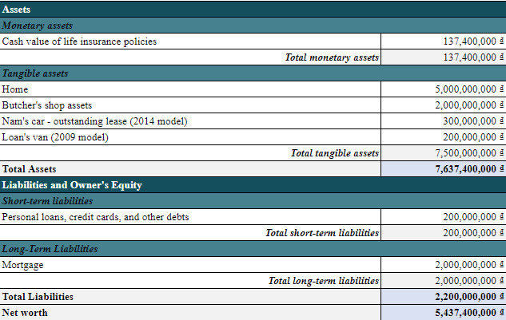
Traditional Balance Sheet Analysis
Nam and Loan exhibit a strong net worth driven by tangible assets.

Slide 7
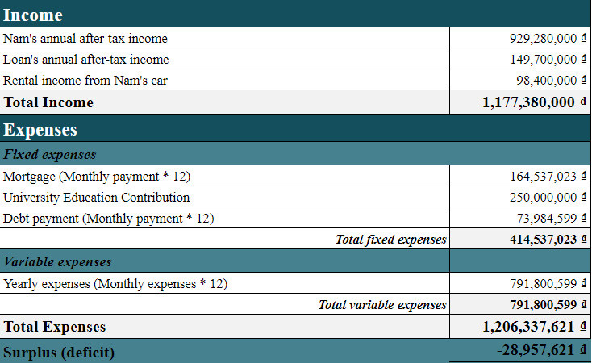
Income Statement Analysis

Slide 8
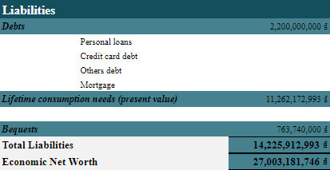
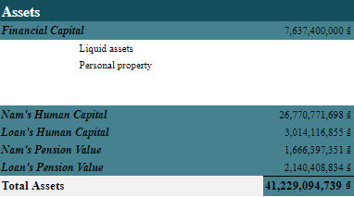
Economic Balance Sheet Analysis
A holistic view reveals a robust financial position. Recommendations encompass prudent debt management, diversified asset allocation, and continuous human capital development.

Slide 9
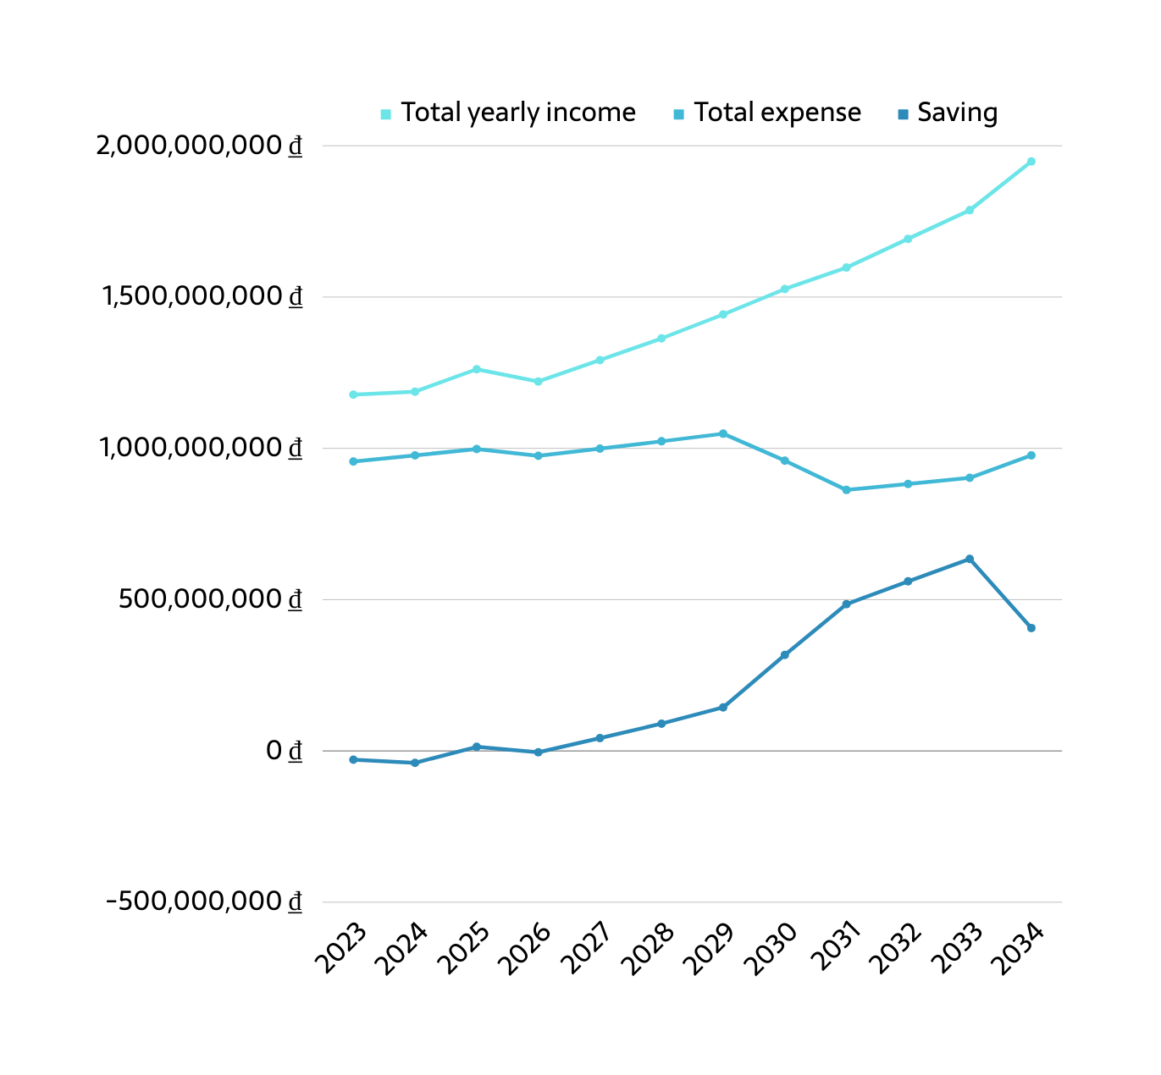
Budgeting Planning
Budgeting involves a surplus strategy, aligning decisions with the overall financial plan.

Slide 10
Section 3: Risk management analysis

Slide 11


Identified risks
based on the background
income fluctuations in Nam's butcher business and Loan's part-time jobs
the threat of premature death impacting family support
potential damage to their home as a crucial asset
uncertainty about their lifespan
legal obligations
health issues

Slide 12

Methods
for dealing with each identified risk
diversifying income, establishing an emergency fund, and exploring additional revenue streams
optimizing life insurance policies
comprehensive home insurance and regular maintenance.
strategic retirement planning
health insurance and aside emergency funds for healthcare expenses, contributing to a robust financial strategy
detailed insurance reviews

Slide 13



PRU-An tâm trọn đời by Prudential
Trọn vẹn cân bằng by AIA
VITA Cho con - Generali
Flexible with no withdrawal or termination fees, but lacks special bonuses upon termination and maintenance bonuses in the first year.
Offers flexibility, comprehensive family protection, but has higher initial fees and more related costs
Flexible with contract maintenance bonuses, but has various related fees and lacks termination bonuses
Compare
between the three insurances in Vietnam

Slide 14
Section 4: Wrap-up
Insurance Analysis
Both of them currently holds a Whole Life policy with limitations and a cash value disadvantage upon conversion to Term Life after 15 years.
Recommended Action
Terminate & switch to TWO new products
Life Insurance with Investment for Child Education Savings:
better alignment with client’s goals and a more flexible approach the funds for their children's education
Tax deductions
Voluntary Social Insurance (VSS): Complying with state regulations, this ensures a more effective financial strategy.
Importantly, the monthly contribution to client's VSS account is partly tax-deductible, allowing her to save 2 million VND per month in her taxable income

Slide 15


Wrap-up
First year premium:
Nam’s contract: 162,000,000 VND
Loan’s contract: 88,000,000 VND
Nam: 1,065,000 VND (monthly)
Loan: 1,065,000 VND (monthly)
Flexible premium payments
Withdrawals can be made without fees starting from the 5th year
Receive monthly income when retired, which can eliminate earning risk and longevity risk.

Slide 16
THANK YOU

